Slide 1
Data scientist final portfolio Project.
Codecademy
- 2021-

Slide 2
What can we find?
In this report it will be possible to obtain information regarding the search for the best machine learning model trained to predict the price of an apartment in Capital Federal, Argentina.
It is structured as follows:
Introduction to the subject.
Exploratory analysis of the chosen data.
Machine Learning models developed.
Optimization of the model with better performance.
Conclusions and next steps.

Slide 3
Introduction to the subject.
This project corresponds to the development of the final project of the Data Science Career Path of Codecademy.
This project proceeds to analyze information regarding the real estate market in the Autonomous City of Buenos Aires, Argentina.
For this purpose, information obtained from the Properati website is used.

Slide 4

Project Goal:
“Create and optimize a machine learning model that, given certain characteristics of an apartment located in the Federal Capital, allows to predict its sale value in dollars.

Slide 5

Exploratory analysis of the data.
The selected database contains:
146,660 rows and 19 columns.
Missing values in 5 columns.
10 different types of published properties.
89 neighborhoods distributed between Capital Federal (CABA) and Greater Buenos Aires (GBA)
The neighborhoods with the highest number of advertisements published are:
Palermo.
Tigre.
Almagro.
Belgrano.
Caballito.

Slide 6
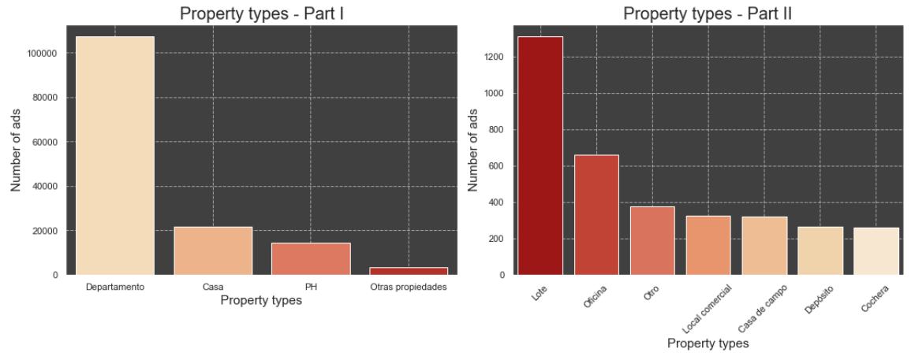
Exploratory data analysis.
Number of ads by property type.

Slide 7
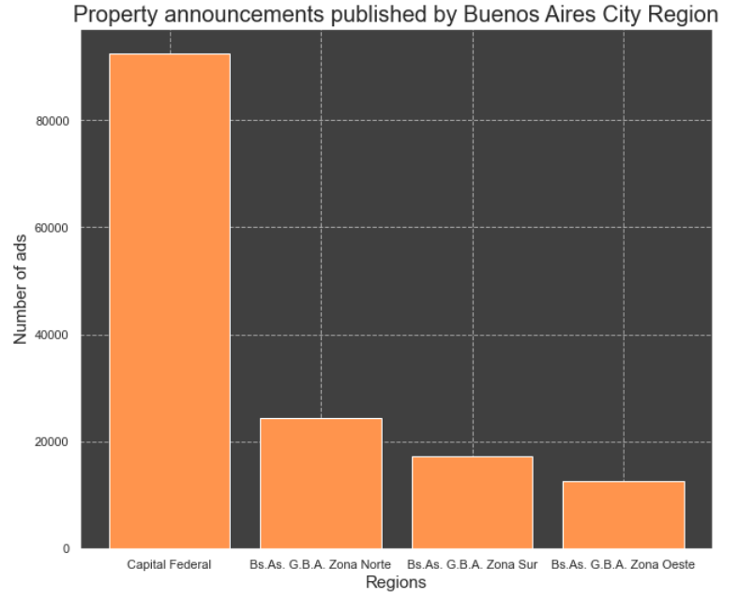
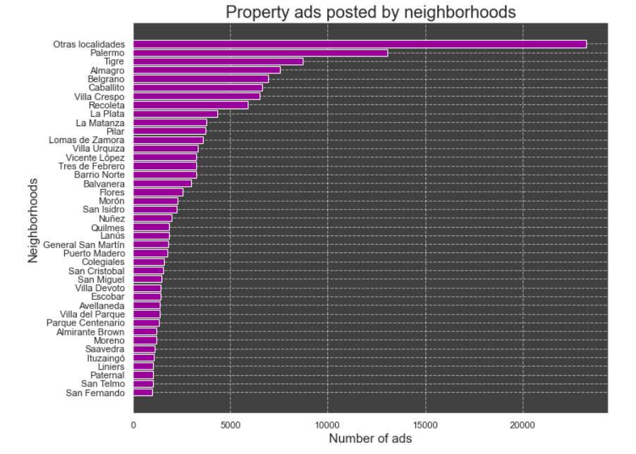
Properties ads By regions and neighborhoods

Slide 8
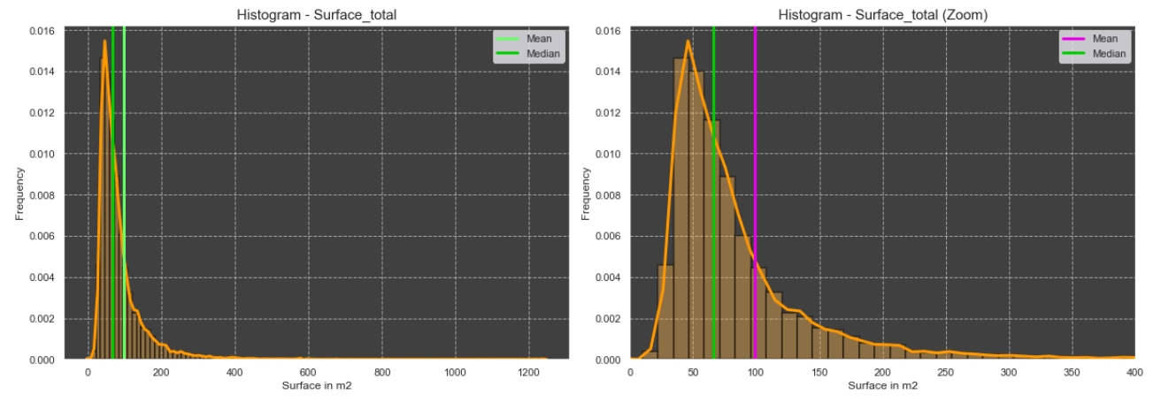
total area of the apartments (m²)
^{Minimum value : 10 m2} ^{Maximum value : 108.960 m2}

Slide 9
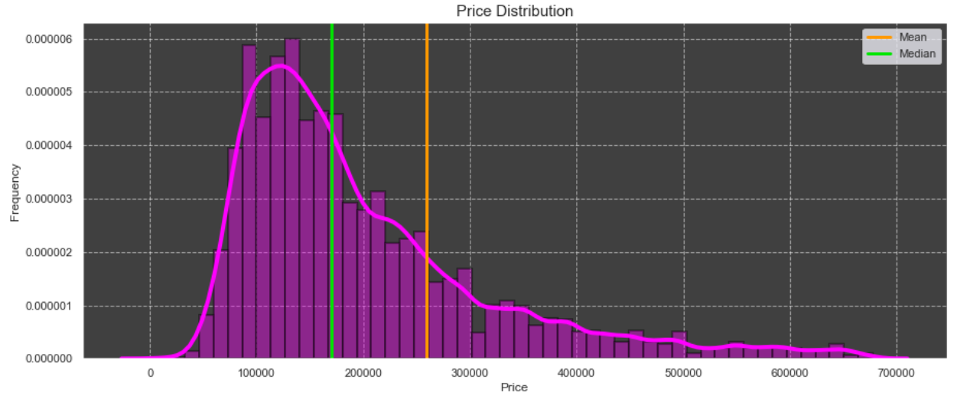
PRICE of the apartmentsles
^{Minimum value : 6.000 USD} ^{Maximum value : 32.434.232 USD}

Slide 10
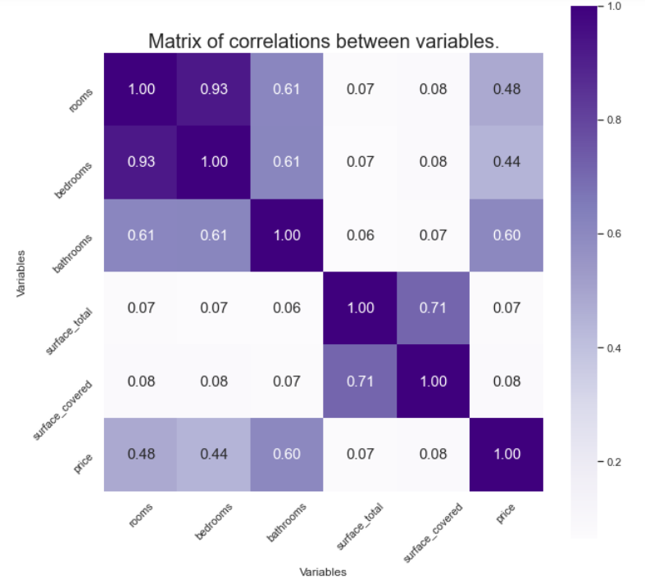
Correlation between variables
Variables analyzed:
Number of Rooms.
Number of Bedrooms.
Number of Bathrooms.
Surface total.
Surface covered.
Price.
The strongest correlations between price and the other variables are presented with respect to the number of bathrooms, rooms and bedrooms.

Slide 11

Data preprocessing.
Eliminate those records where the amount of covered square meters is greater than the total meters of the property.
Delete records whose total area is greater than 1000 m2 and less than 15 m2
Delete the records whose price is higher than 4 million dollars.
Standardization of quantitative variables.
Transform the categorical variable into dummies.

Slide 12

Machine Learning Models
Models:
Decision Tree Regression.
Regression K nearest neighbor (KNN).
Multiple Linear Regression.
Variable to predict:
Price.
Predictor variables:
Rooms
Bedrooms
Bathrooms
Total Surface
Covered Surface
Neighborhood - dummy variables

Slide 13
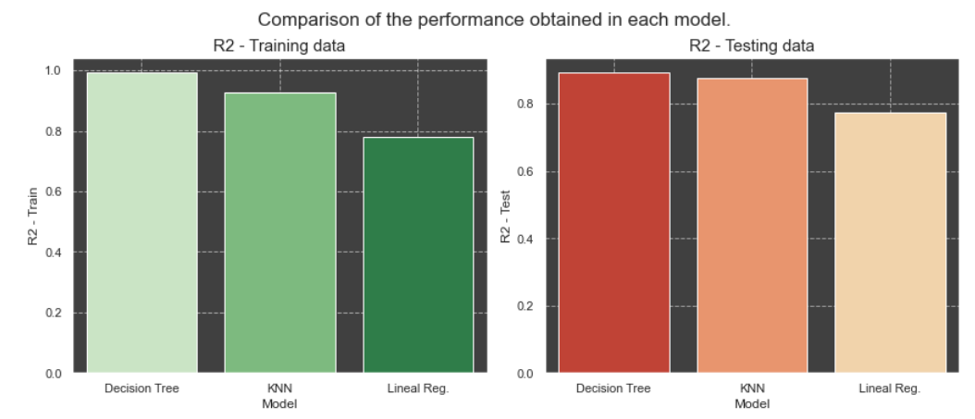
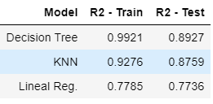
Performance obtained.
Selected metric: “R2”
This allows to measure the goodness of fit of the model.
It varies between 0 and 1

Slide 14
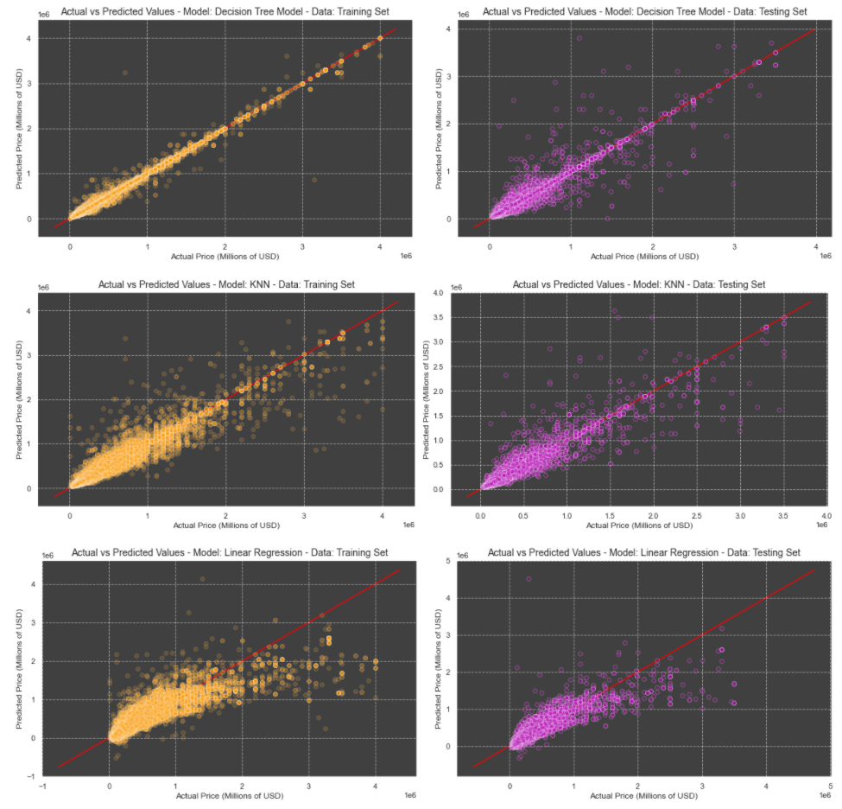
Real values vs. Predicted Values
The models have difficulty to predict the price of apartments that have a high market value.
For prices below 1.5 million USD, the data are concentrated close to the red line drawn. Likewise, as the price increases, saturation decreases, confirming the difficulty of the model to predict high market prices.

Slide 15
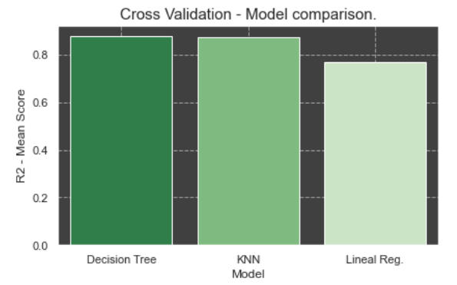
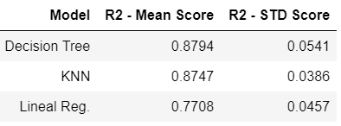
Cross validation performance
MODEL TO OPTIMIZE:
Decision Tree Model was chosen to optimization process because it has obtained the best result for the R2 score.

Slide 16
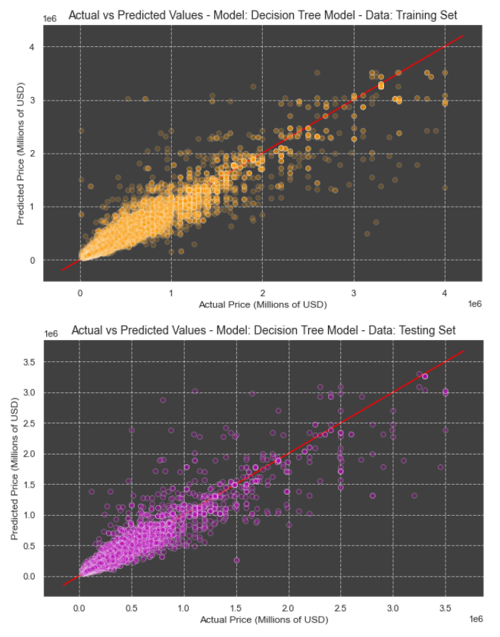
Optimized model
Hyperparameters:
max_depth = None
min_samples_split = 2
min_samples_leaf = 10
Mean R2 obtained:
Training set: 0.9137
Testing set: 0.8811
From the optimization of the hyperparameters, it was possible to obtain a better result for the training set and reduce the overfitting that occurred in the training set.

Slide 17
Conclusions
The decision tree model has a better predictive value of apartment prices than the KNN and Linear Regression models.
The trained and optimized decision tree model allows us to predict (with good precision) the value of properties with a market valuation when the real price of the apartment is less than $ 2 million USD.
For prices greater than 2 million USD, the model presents difficulties, so I recommend to consider these prices as reference prices.
NEXT STEPS.
The model could be enriched by incorporating information about public services or transportation alternatives that the properties have.
The scope of the model could be expanded, being able to predict the price of houses, offices, etc.

